Slide 1


WHAT’S BREWING IN SOUTH AFRICA
A Supply Chain Analysis for Heineken®
Notes:
https://www.theheinekencompany.com/sites/theheinekencompany/files/Investors/financial-information/results-reports-presentations/Heineken-NV-AR-2022--23_02_2023_1.pdf
Chaim

Slide 2
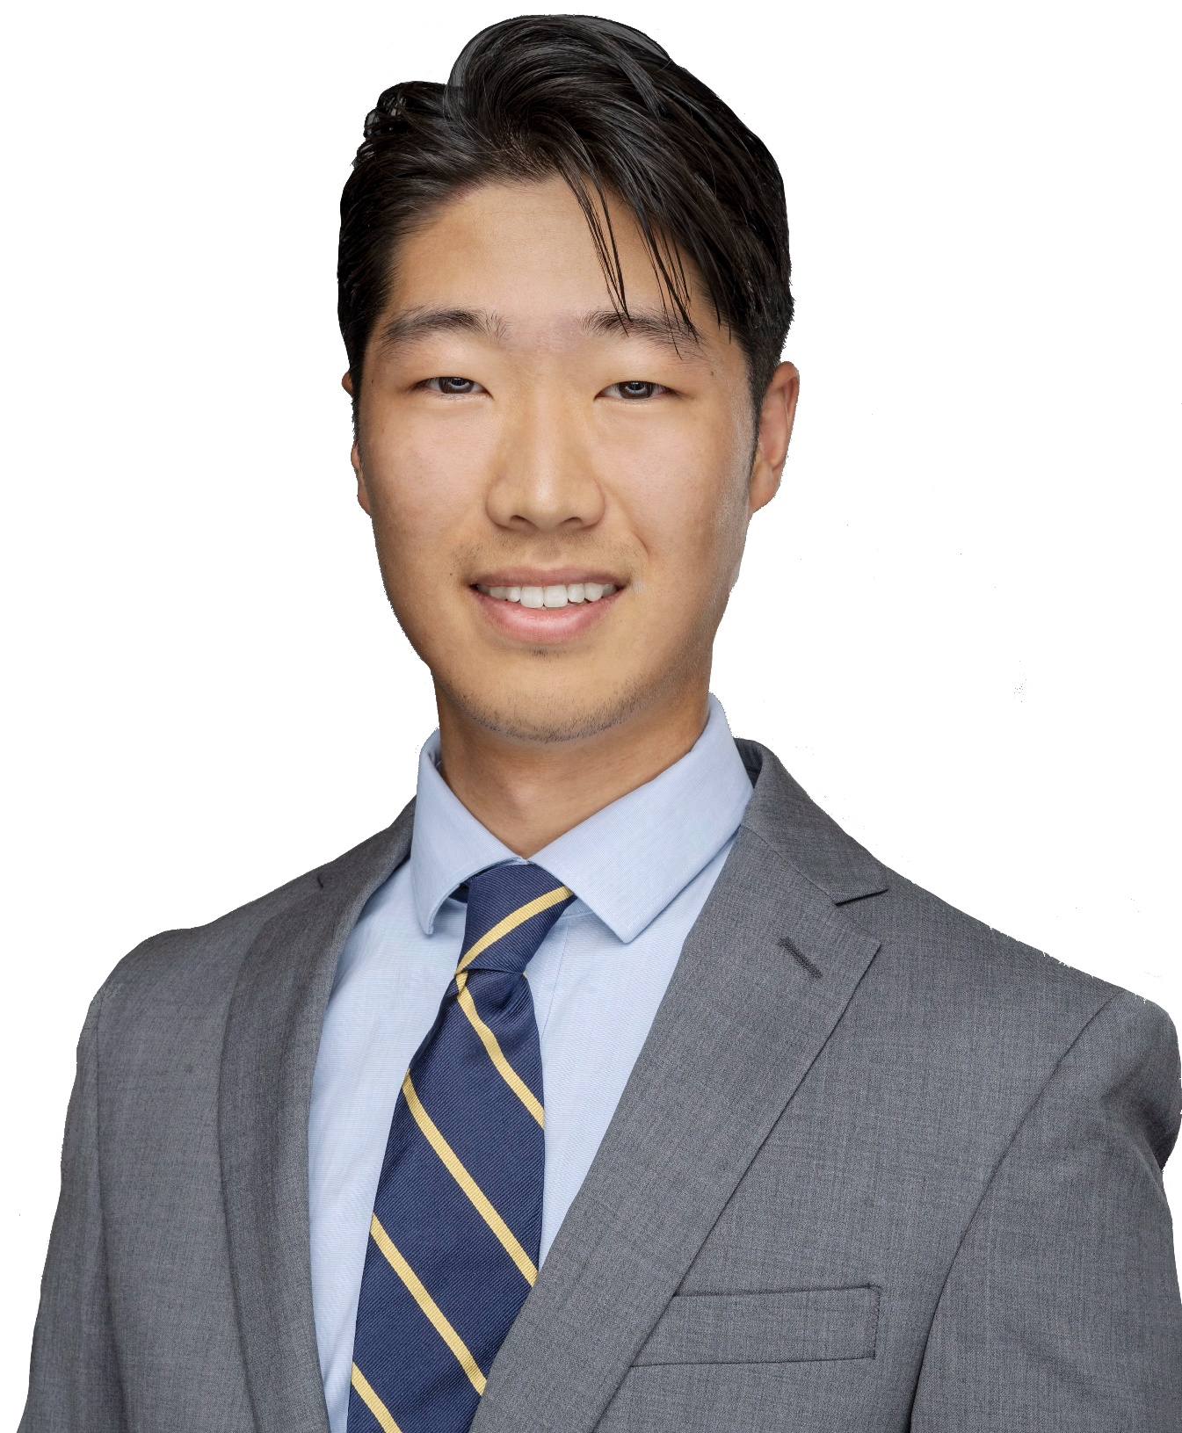
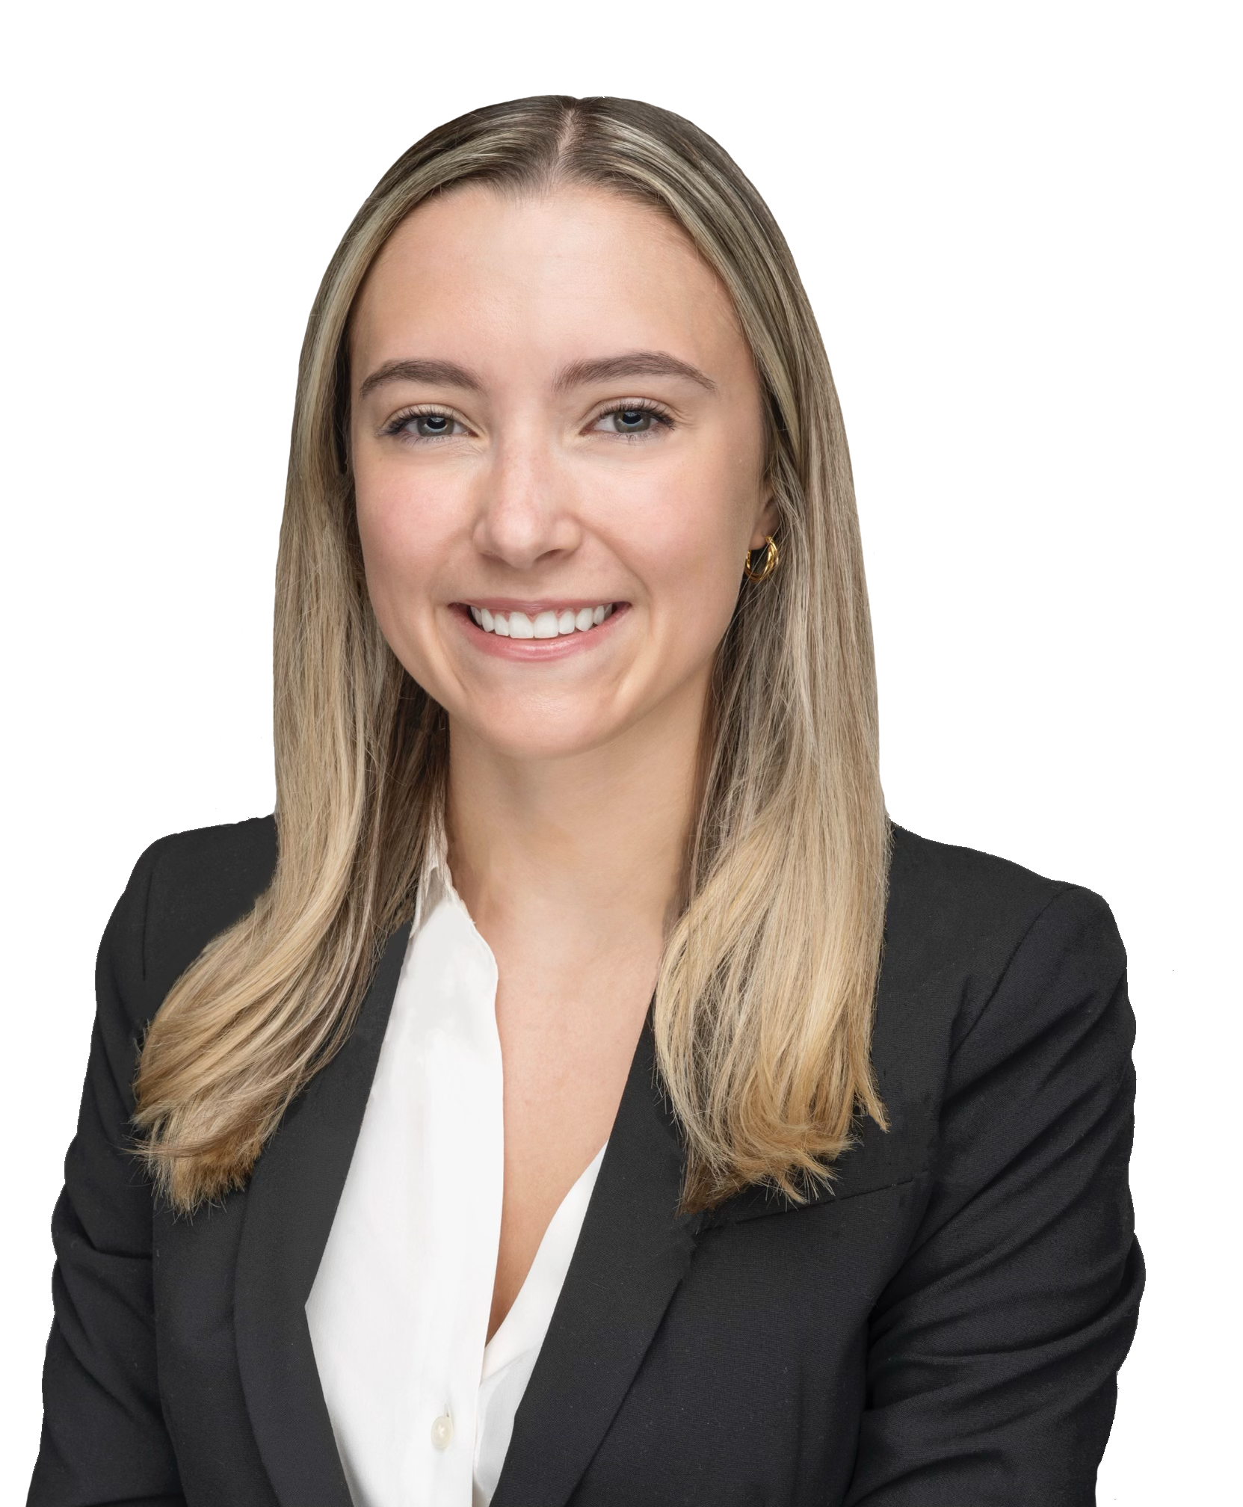
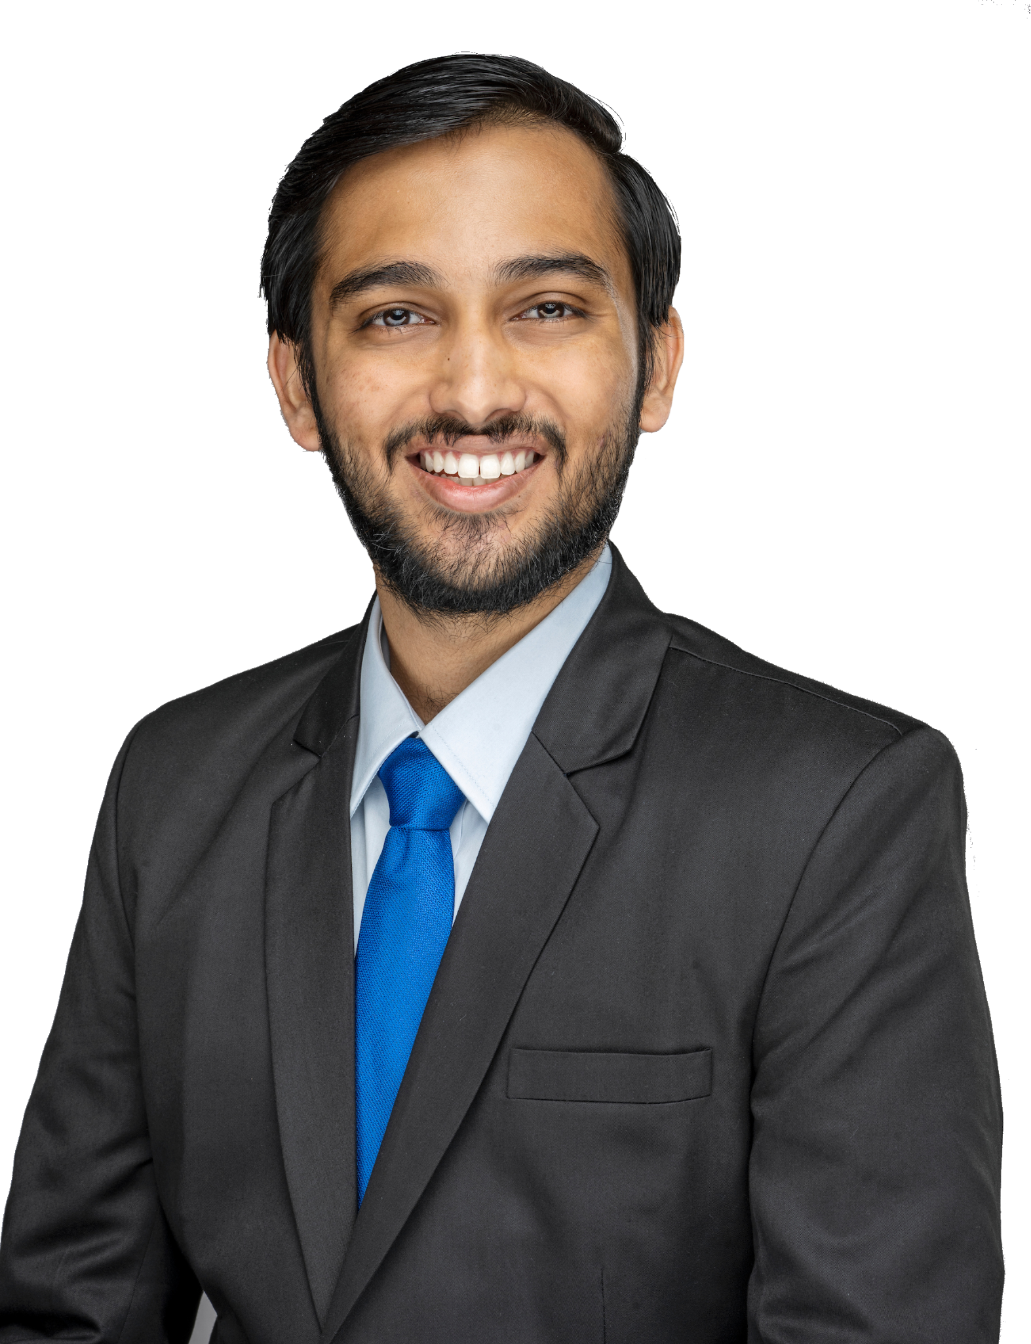
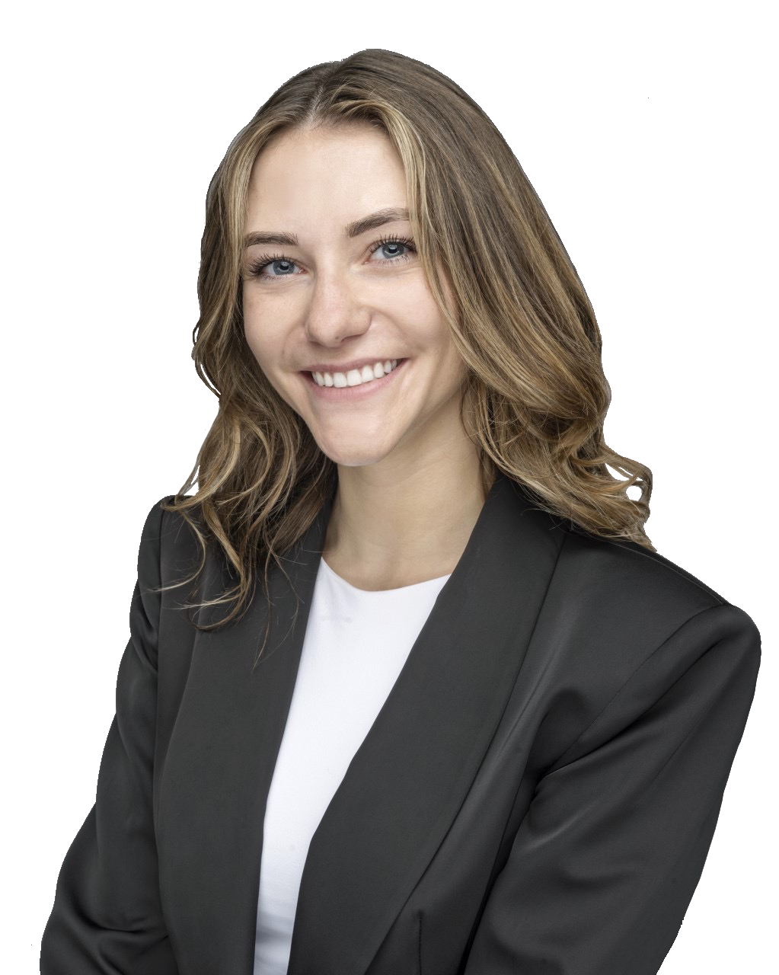
MEET THE MEMBERS
TEAM 14
Chaim Yi
Jillian Wedin
Vedant Kulkarni
Sarah LaBorde
2023 MSBA Candidate
2023 MSBA Candidate
2023 MSBA Candidate
2023 MSBA Candidate
BS Personal Finance
BBA Finance, Investment, & Banking
BS Mass Communication & Management Information Systems
BBA Finance, Investment, & Banking; and Marketing
Notes:
Team Members & Roles
Chaim

Slide 3
SITUATION
OPPORTUNITY
HEINEKEN is global beer company with legacy of innovation and sustainability
Currently they desire to optimize their operations in South African regions
The South African market is expected to grow by 30%¹
HEINEKEN can capitalize on consumer preferences and forecast demand to increase future sales
QUESTIONS
Customer Segmentation
Product Mix Offerings
Product Popularity
Demand Forecasts
Distribution Footprint
1 | Heineken. “Heineken N.V. Reports 2021 Full Year Results Key Highlights.” Theheinekencompany.com, The Heineken Company, 2022, https://www.theheinekencompany.com/sites/theheinekencompany/files/Investors/financial-information/results-reports-presentations/Heineken-NV-2021-Full-Year-Results-press-release.pdf.
Notes:
Chaim

Slide 4
KEY AREAS OF OPPORTUNITY
Focus on Operation Optimization, Customer Preferences, & Market Share
ENHANCE DISTRIBUTION
POSITION AS PREMIUM EXPERIENCE
3
MODIFY PRODUCT OFFERINGS
1
2
Balance efficient and responsive strategies
Aspirational customers view premium items as high value
Drop underperforming product lines and then reallocate cost savings
Notes:
Chaim

Slide 5
MARKET LANDSCAPE
High Level, Top Lines, & Competition
Notes:
Chaim

Slide 6
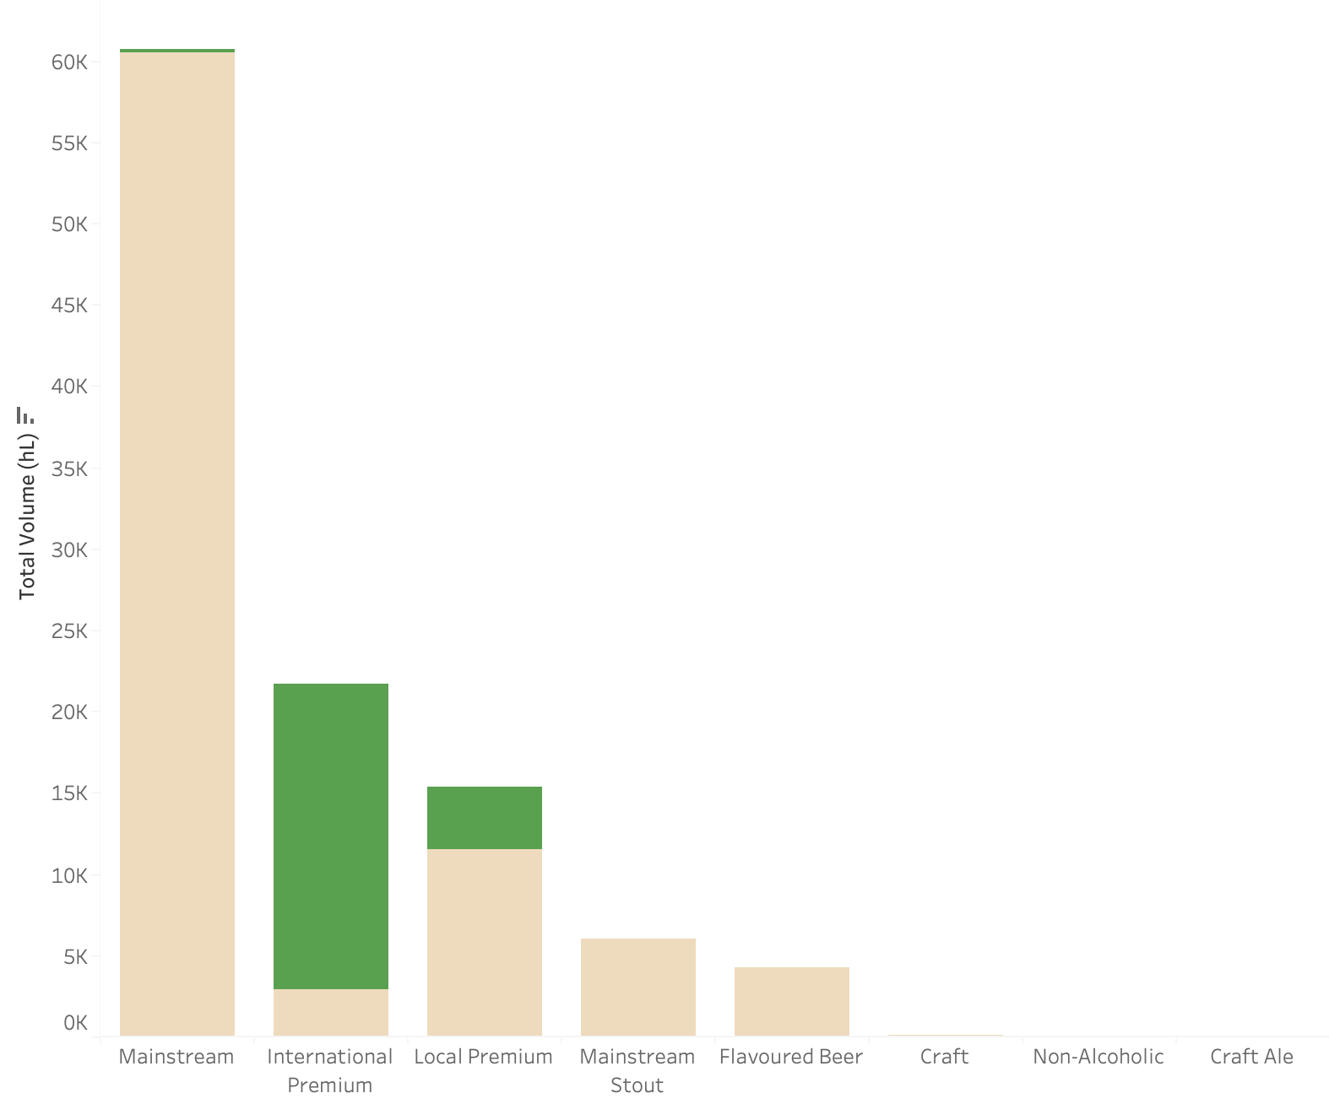
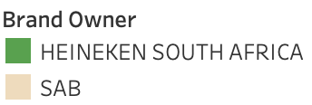
HIGH LEVEL HEINEKEN
HEINEKEN’s International Premium Items Drive Majority of Their Market Share
108.2 k
Total Market hL
HEINEKEN: 22.8k
26.81%
HEINEKEN’s Share of Market Sales .
Notes:
Chaim

Slide 7
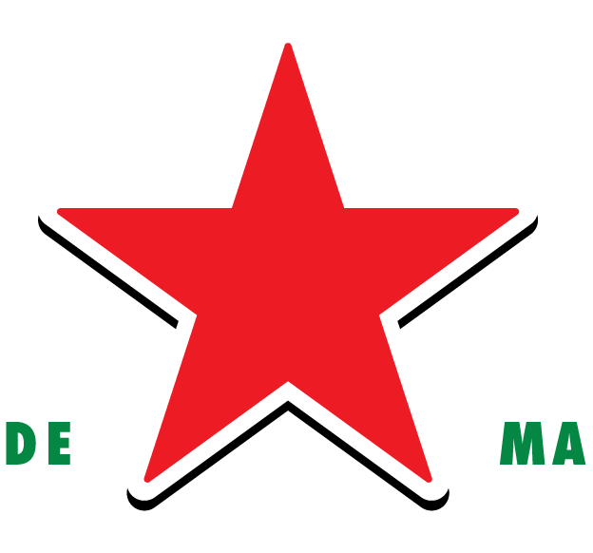
HIGH LEVEL HEINEKEN
HEINEKEN’s International Premium Items Drive Majority of Their Market Share
108.2 k
Premium Branding Appeals to Aspirational Consumers
Total Market hL
HEINEKEN: 22.8k
26.81%
HEINEKEN’s Share of Market Sales .
Notes:
Chaim

Slide 8
DRIVERS OF SALES
Consumer Profiles & Product Mixes
Notes:
But let’s find out who is driving this growth
Sarah

Slide 9



CUSTOMER SEGMENTATION
Four Groups of Customers Based on K-Proto Clustering Model
CLUSTER 1
29.95%
CLUSTER 3
9.65%
Eastern Cape
Mpumalanga
Nelson Mandela Bay Metropolitan
Steve Tshwete
Mpumalanga
Limpopo
Emalahleni
Greater Tzaneen Local Municipality
32.67%
CLUSTER 2
27.73%
CLUSTER 4
Note: specifics on cluster results can be located in the appendix
1 | “Statistics South Africa on Community Survey 2016 Results.” South African Government, July 1, 2016. https://www.gov.za/speeches/community-survey-2016-results-1-jul-2016-0000#:~:text=The%20population%20of%20South%20Africa,Eastern%20Cape%20(7%20million).
Notes:
Segway: but what are the purchasing habits?
How do we need to build cluster stsory
Sarah
Did a clustser analysis using radiant - using the information provided

Slide 10
CUSTOMER SEGMENTATION
Four Groups of Customers Based on K-Proto Clustering Model
CLUSTER 1
29.95%
CLUSTER 3
9.65%
Eastern Cape
Mpumalanga
Nelson Mandela Bay Metropolitan
Steve Tshwete
International
Premium Lines
On Trade
Regular Taverns
Individual Bottles
Mpumalanga
Limpopo
Emalahleni
Greater Tzaneen Local Municipality
32.67%
CLUSTER 2
27.73%
CLUSTER 4
Note: specifics on cluster results can be located in the appendix
1 | “Statistics South Africa on Community Survey 2016 Results.” South African Government, July 1, 2016. https://www.gov.za/speeches/community-survey-2016-results-1-jul-2016-0000#:~:text=The%20population%20of%20South%20Africa,Eastern%20Cape%20(7%20million).
Notes:
Segway: but what are the purchasing habits?
Sarah

Slide 11
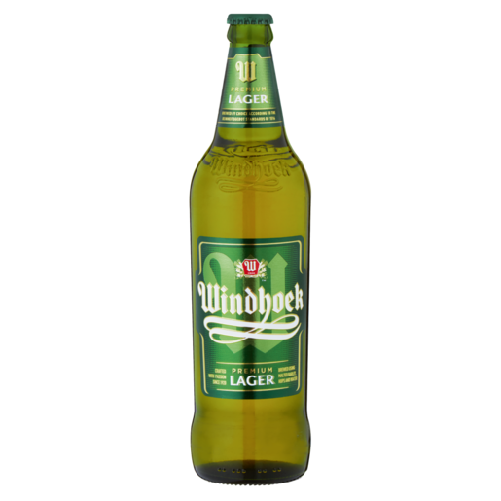
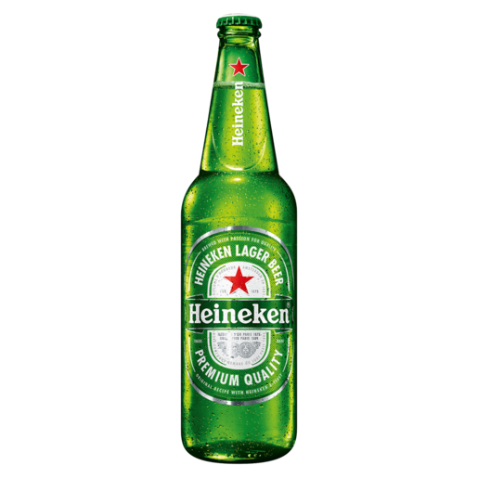
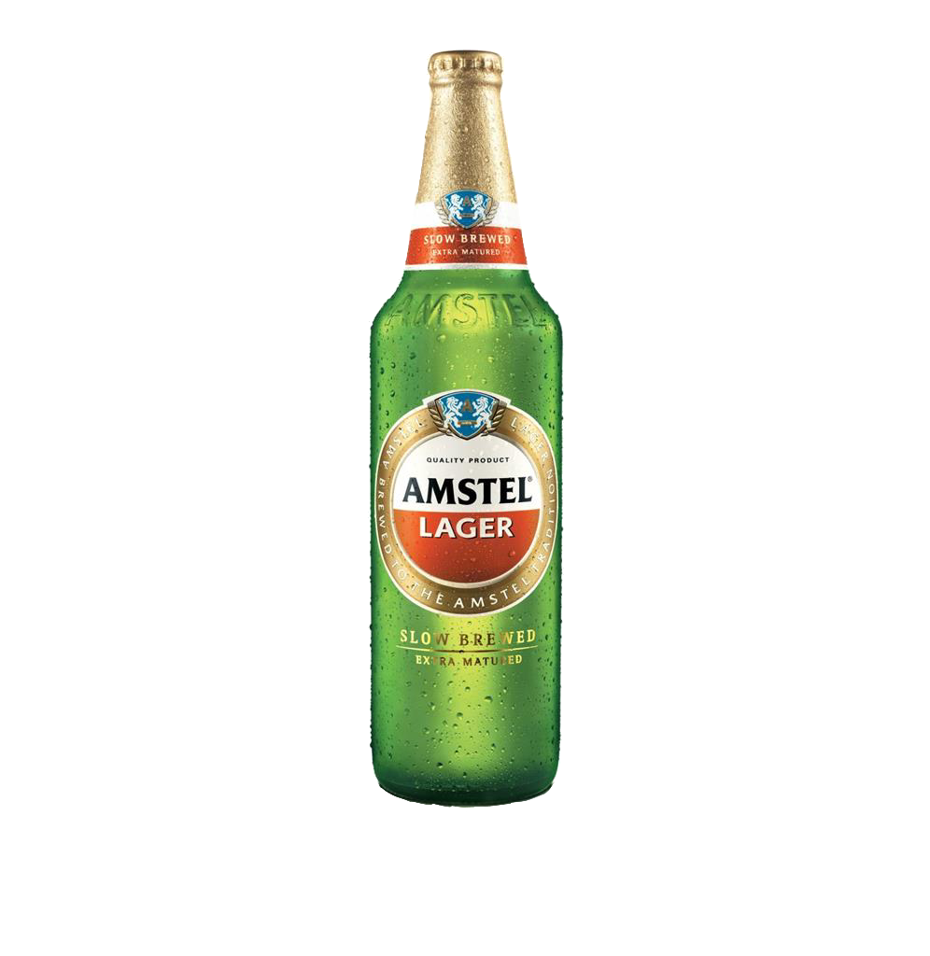
CUSTOMER SEGMENTATION
These Census Aided¹ Clusters Identify ‘High-Value’ Persons for Future Sales
CLUSTER 1
CLUSTER 3
Lager loving
Young black adults
Stable income
Urban Areas
Lager loving
Middle-aged black parents
Stable income
Urban areas
Lager loving
Young black males
Stable income
Traditional areas
Lager loving
Young black parents
Low income
Traditional areas
CLUSTER 2
CLUSTER 4
Note: specifics on cluster results can be located in the appendix
1 | “Statistics South Africa on Community Survey 2016 Results.” South African Government, July 1, 2016. https://www.gov.za/speeches/community-survey-2016-results-1-jul-2016-0000#:~:text=The%20population%20of%20South%20Africa,Eastern%20Cape%20(7%20million).
Notes:
Sarah

Slide 12
ASSESSING VOLUME
Forecasted Models, & Volume Predictions
Notes:
Jillian

Slide 13
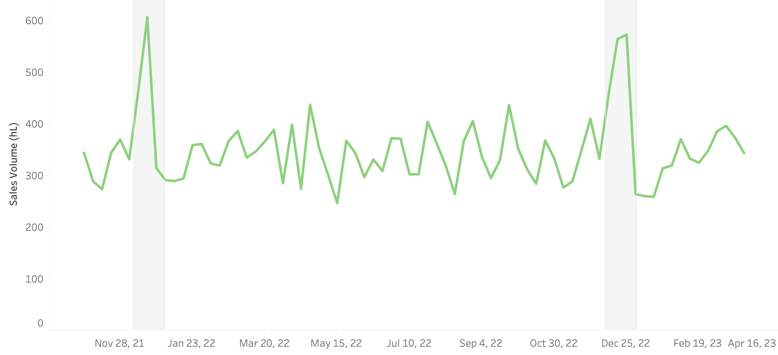
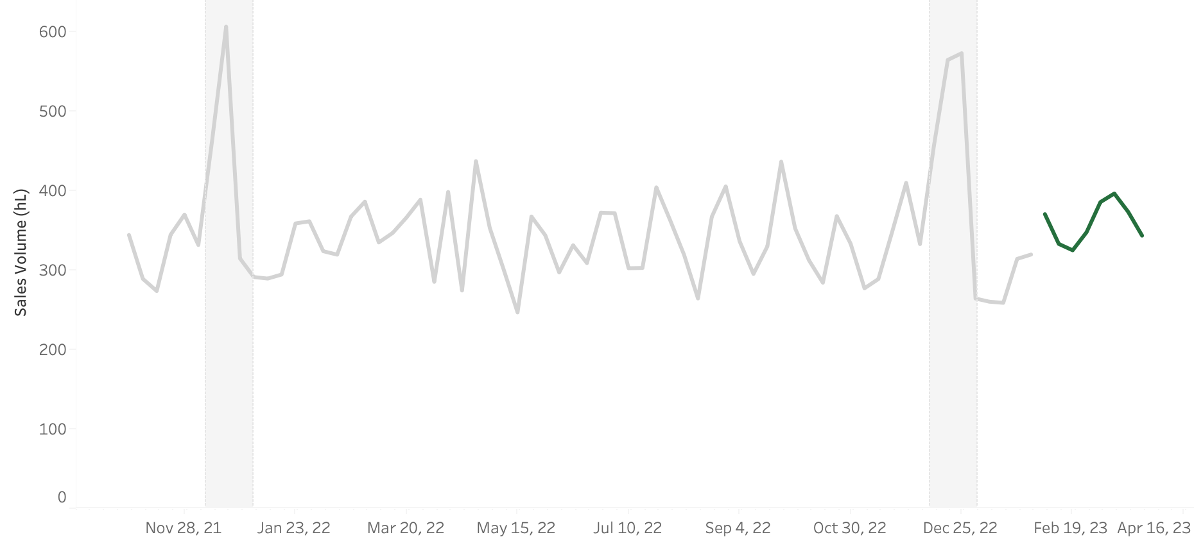
DEMAND FORECASTING MODEL
Using Prophet Time Series via Python to Forecast 8-Week Sales Volume
Summer Holiday Season
Summer Holiday Season
MAPE: 13.17708
Below 20% Standard
Note: Predicted by brand level and aggregated hL via bottom up approach | brand breakdown in appendix
Notes:
volume (hL) = 0.450589*Week -19912
Mention other brand forecasts in the appendix
The Mean Absolute Error (MAE) is calculated by taking the mean of the absolute differences between the actual values (also called y) and the predicted values (y_hat).
Jillian

Slide 14
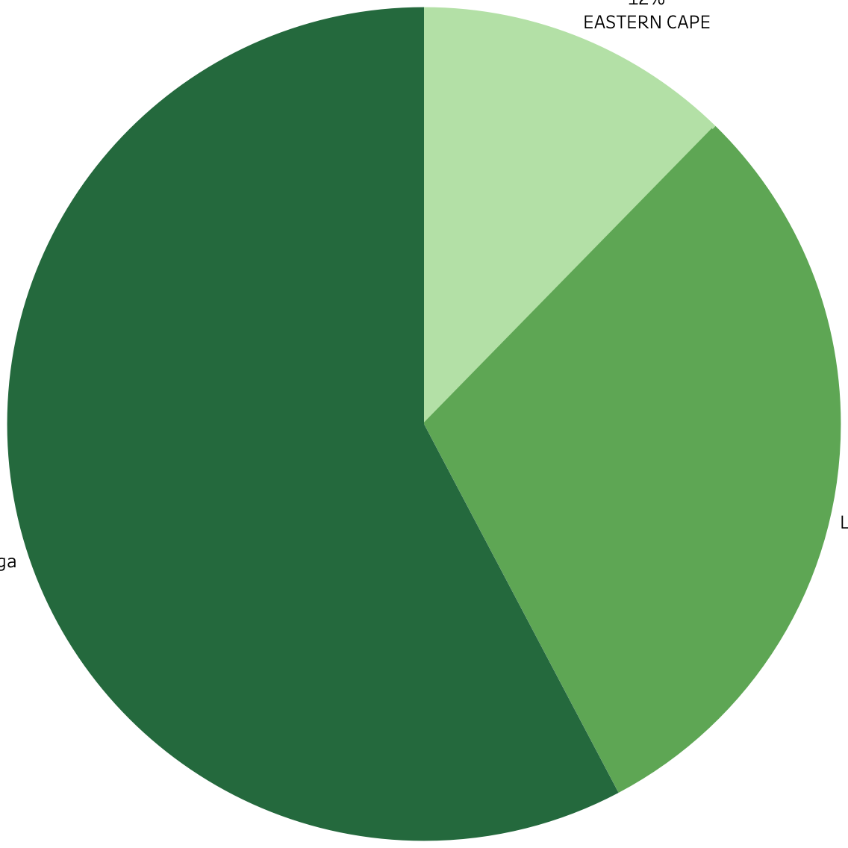
MANUFACTURING & RESUPPLY VOLUME
2,868 hL Must be Manufactured to Meet Total 8-Week Demand
Week | Limpopo | Mpumalanga | Eastern Cape
1 | 45.53 | 110.74 | 213.26
2 | 40.92 | 99.53 | 191.68
3 | 40.92 | 99.53 | 191.68
4 | 42.73 | 103.93 | 200.14
5 | 47.40 | 115.29 | 222.03
6 | 48.72 | 118.51 | 228.22
7 | 45.89 | 111.61 | 214.94
8 | 42.21 | 102.67 | 197.72
Manufacturing Production (hL) | Distributor Restock (hL)
369.5237 | 701.65
332.1271
332.1271 | 678.93
346.8013
384.7172 | 780.17
395.4561
372.4320 | 715.03
342.5948
2,867.772
TOTAL hL
Needed to meet 8 week demand
Eastern
Cape
12.3%
Limpopo
30%
Mpumalanga
57.7%
Note: safety stock from 2 week lead time resupply is 359.47 hL
Notes:
Formatting Shift when transferring state titles from excel, please note these should instead
Average 8 week values for distributor restock
50% of average 2 week resupply window hL
How did we calculate the state level values?????
Jillian

Slide 15
DISTRIBUTION PATHWAYS
Facility Placement & Stock Considerations
Notes:
Vedant

Slide 16
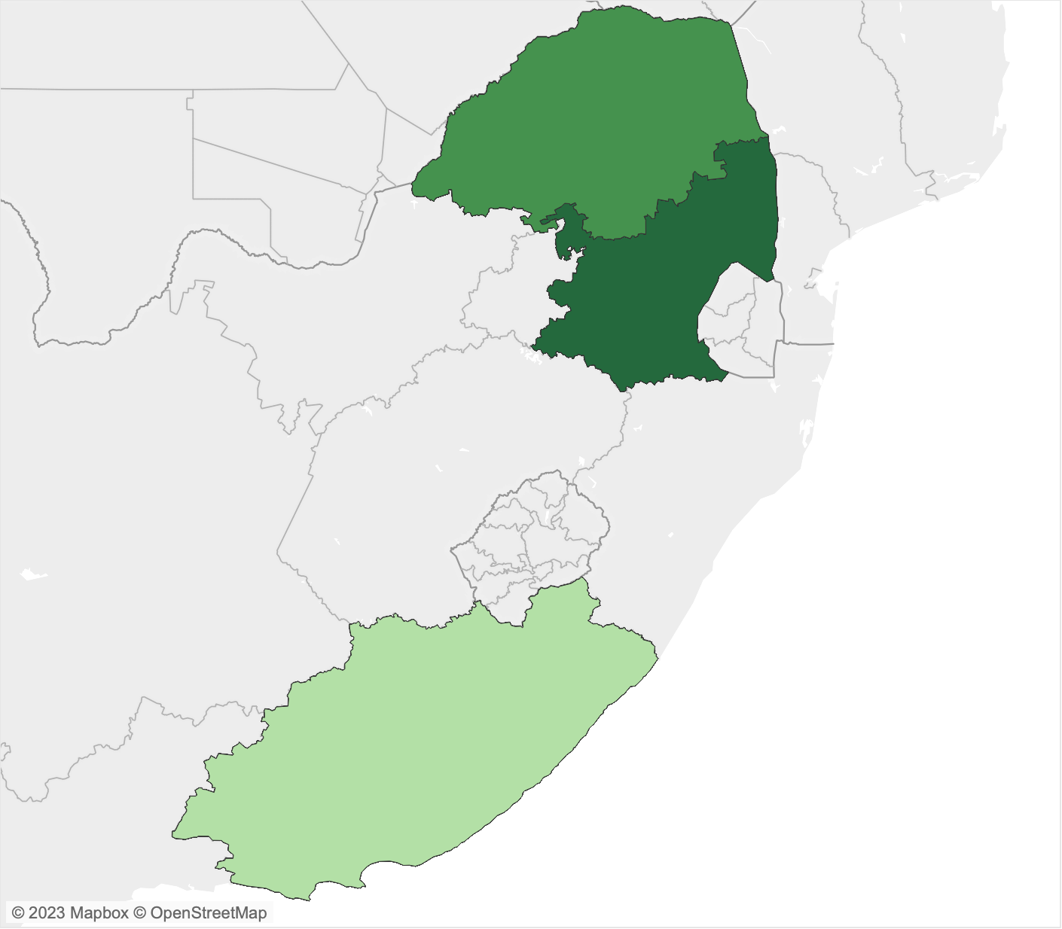
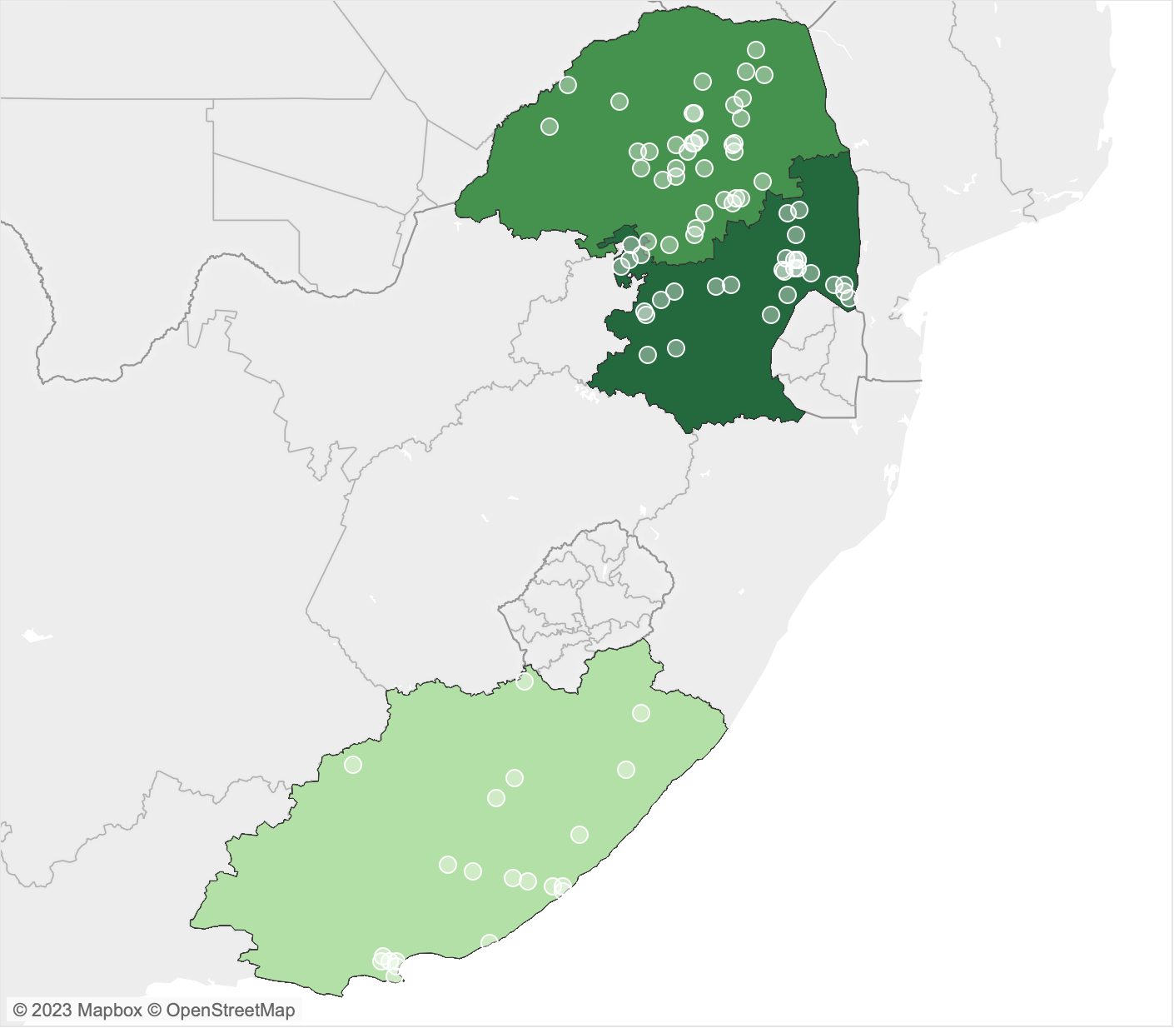
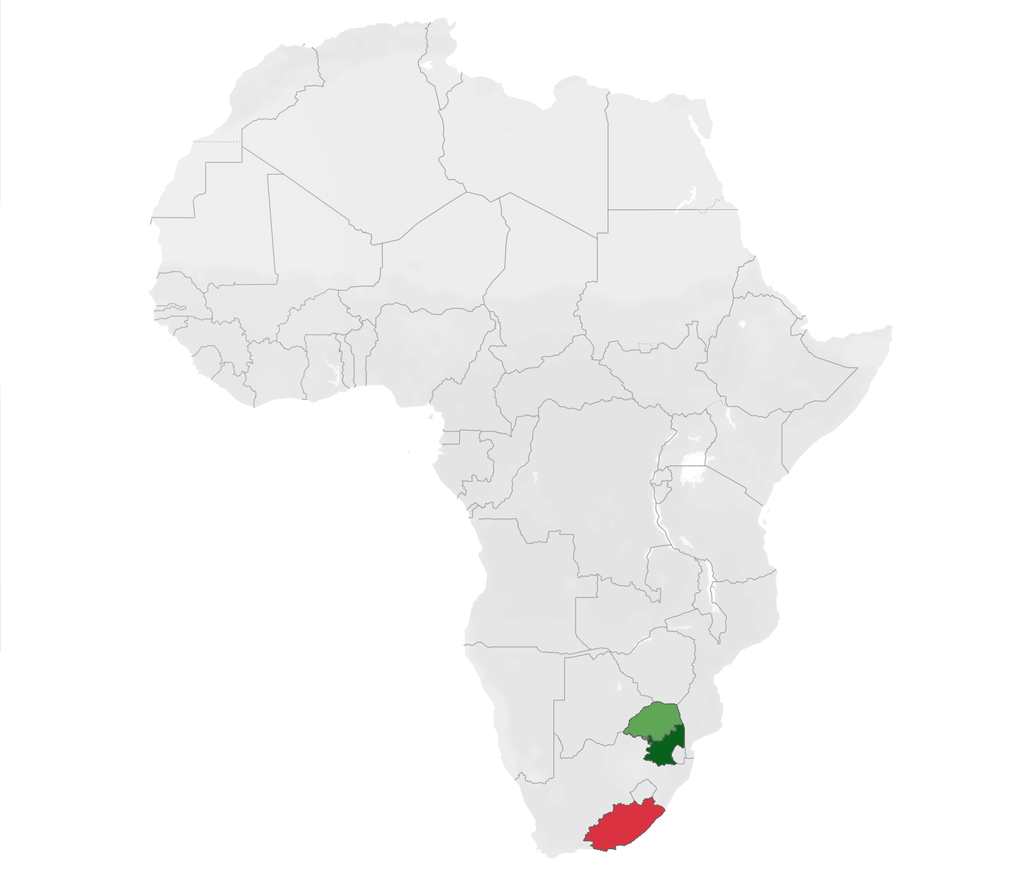
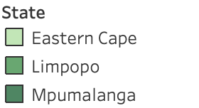
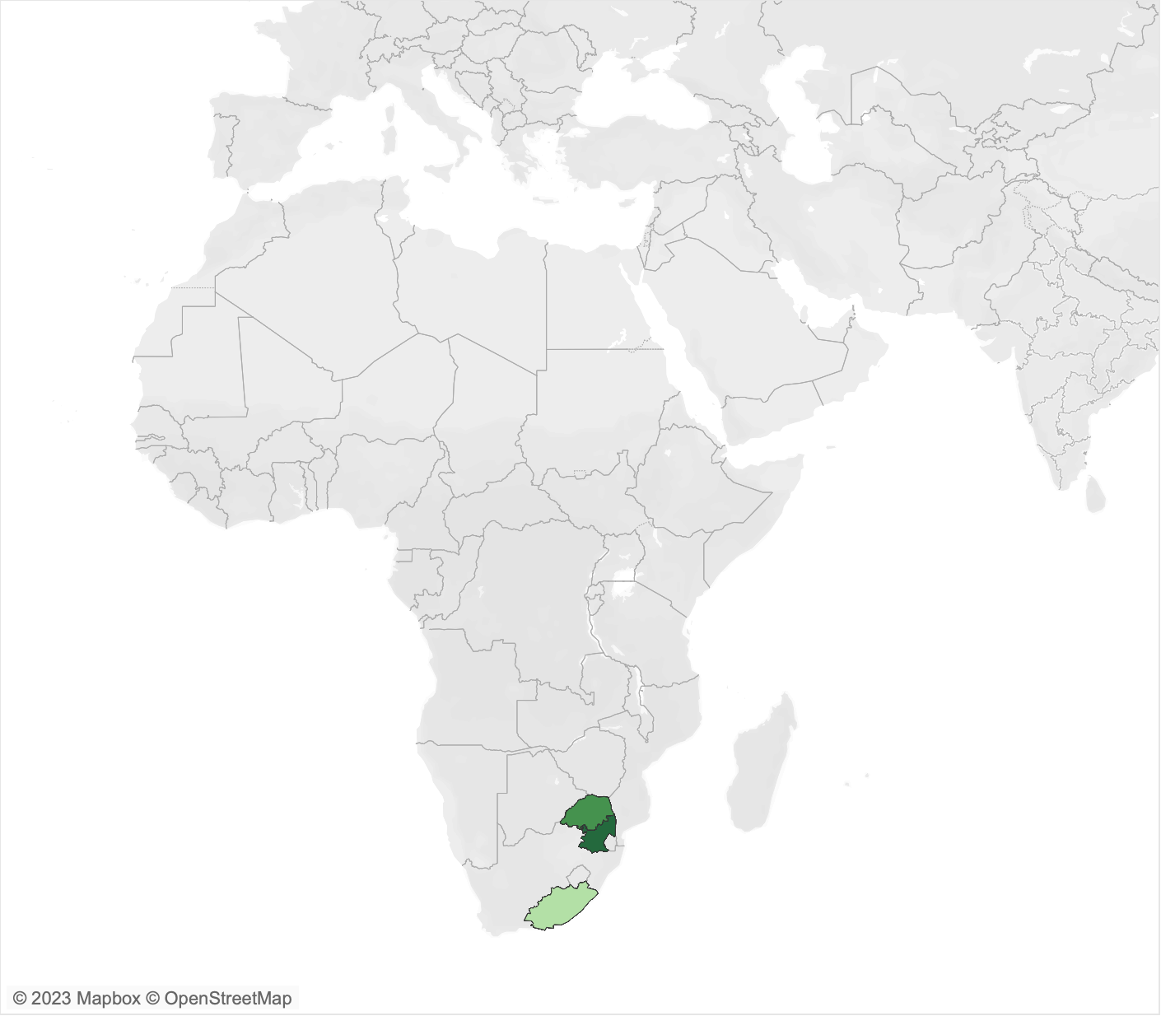
Manufacturing Facility
Johannesburg
2,868
8 WEEK
LEAD TIME
hL
PRODUCED EVERY 8 WEEKS
Notes:
Vedant

Slide 17

Manufacturing Facility
Johannesburg
2,868
8 WEEK
LEAD TIME
hL
PRODUCED EVERY 8 WEEKS
Distribution Centers
Polokwane, LM | Witbank, MP | East London, EC
2 WEEK
RESUPPLY
223 K
2.63 M
Annual Shipping Cost
Annual Operations Cost
Note: calculations can be found in appendix
Notes:
Polo-kwaa-nay
Wit-bank
East london
Locations of Manufacturer & Distribution
Midpoint (1 vs 3) (R - shelf space)
Minimize costs
Operations, foundation, shipping)
Vedant

Slide 18
Manufacturing Facility
Johannesburg
2,868
8 WEEK
LEAD TIME
hL
PRODUCED EVERY 8 WEEKS
Distribution Centers
Polokwane, LM | Witbank, MP | East London, EC
2 WEEK
RESUPPLY
223 K
2.63 M
Annual Shipping Cost
Annual Operations Cost
Customer Cities
Limpopo
Mpumalanga
Eastern Cape
35
28.6 K
32
51.3 K
25
57.2 K
customers
Annual Shipping Cost
customers
Annual Shipping Cost
customers
Annual Shipping Cost
Note: calculations can be found in appendix
Notes:
Vedant
Annual shipping is from distribution to custom
Not anything by clusters

Slide 19
GOING FORWARD
Expected Volume and Product Line Assessments
Notes:
Use trends in E -> setting and betting
35% profit margin
Jillian

Slide 20
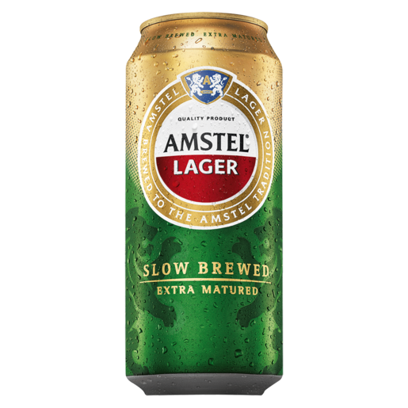
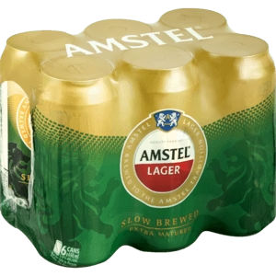
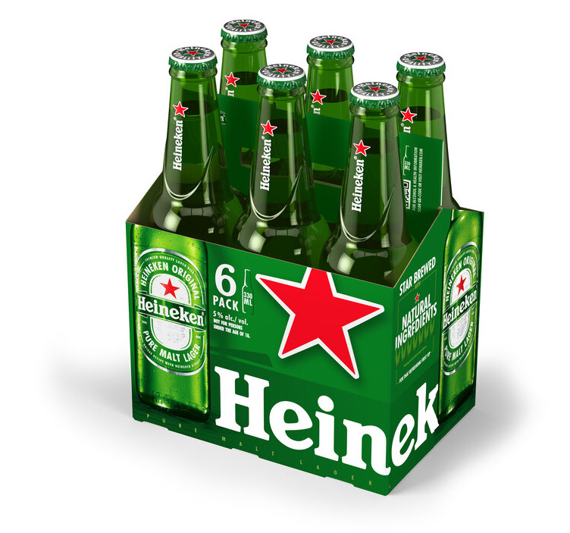
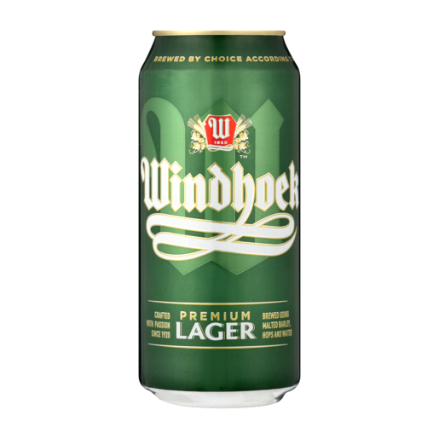
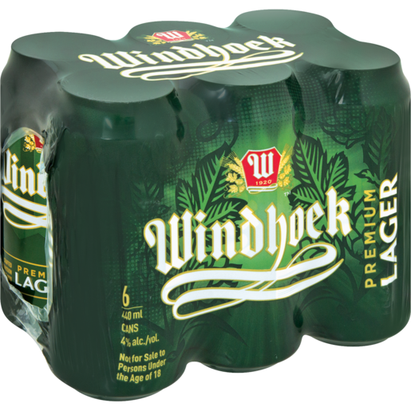
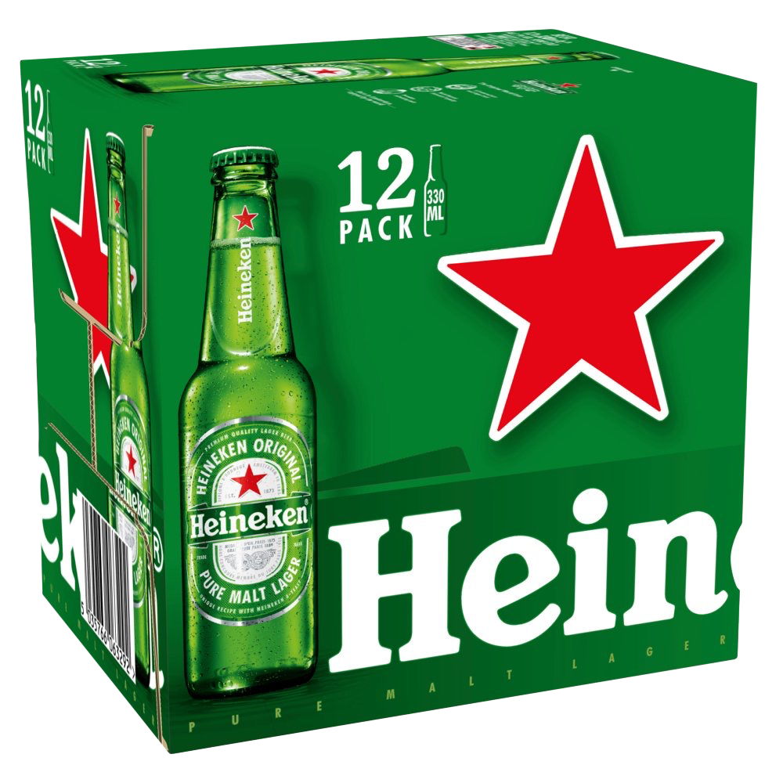
PRODUCT LINE FORECASTS FOR TOP BRANDS
HEINEKEN’S Top Selling Product Lines Have Favorable Forecasts
57.7% Mpumalanga
30% Limpopo
12.3% Eastern Cape
Amstel Lager
Product | Volume (hL)
Amstel Lager RB 660ml | 557.08
Amstel Lager Can 440ml | 35.22
Amstel Lager Can 6x440ml | 18.12
Heineken Lager
Product | Volume (hL)
Heineken Lager NRB 650ml | 1,068.06
Heineken Lager NRB 12x650ml | 124.71
Heineken Lager NRB 6x330ml | 81.99
Windhoek Lager
Product | Volume (hL)
Windhoek Lager Can 440ml | 46.96
Windhoek Lager NRB 330ml | 31.63
Windhoek Lager Can 6x440ml | 24.32
How many of a particular product should we be producing in the future?
Notes:
Jillian

Slide 21
PRODUCT BETTING & SUN SETTING
Retire Light Beers and Launch Flavored Beverage to Capture Market Share
BETTING BRANDS
Premium International | Flavored Beer: Sol
High volume for competitor in flavored category
Reinforce efforts for namesake brands & premium experiences
SUN SETTING BRANDS
Amstel Radler | Tafel Lager | Windhoek Light | Amstel Light
Radler underperforms against mainstream category
Tafel lager is worst performing lager with little growth
Growing and capturable market for mainstream lagers
Light beer category has decreasing market share overall
Note: forecasts for each brand can be found in the appendix
Notes:
Jillian

Slide 22
ENHANCING DISTRIBUTION
Three Locations Lowers Costs and Increases Customer Satisfaction
Responsive:
Adapts to demand change
Closer proximity to customers
Capacity for 10 year forecasts
Efficient:
Inventory turnover of 6.5x
Centroid locations minimize distance
Dropping lines lowers inventory costs
Three centers reduces shipping costs
1
Balance Responsive & Efficient Supply Chain Strategies
Notes:
Referring back to slide 7
Sarah

Slide 23
POSITION AS PREMIUM EXPERIENCE
Appeal to Aspirational Customers Who Desire a Premium Experience
Demographic Segmentation:
Target customers defined by clusters
Lager preference
Ethnicity
Age
Residence area type
Financial standing
Best Performance:
Premium product lines have the strongest market share
2
Aspirational Customers View Premium Items as High Value
Notes:
Referring back to slide 7
Sarah
Heineken is the leading premium brand in the South African market over SAB, and takes a competitive pricing strategy by pricing itself slightly lower than SAB.

Slide 24
MODIFYING PRODUCT OFFERINGS
Retire Light Beers and Launch Flavored Beverage to Capture Market Share
Dropping Lines:
Drop underperforming products
Light beers, Radler, & Tafel Lager
Reallocate cost savings to other lines
Launching New Products:
Produce and sell budding product types to prepare for future demands
Capture competitor market volume from flavored beer category
Utilize Sol for unique flavor profiles
Maintain 35% profit margin
3
Capture Market Share & Drop Poor Performing Product Lines
Notes:
Referring back to slide 7
Sarah

Slide 25
THANK YOU

Slide 26
APPENDIX
Data
Clusters:
Distribution Centers
Brand Forecasts:
Sunsetting & Betting:

Slide 27
Slide 26: APPENDIX.
APPENDIX: DATA

Slide 28
DATA CLEANING
Slide 26: APPENDIX.
SALES AND CUSTOMERS
Data Cleaning:
Removed the 12 records with null values from the customers data set
Dropped the sales associated with the null values
Added a new column that converts the RAND sales value to USD
Added a new column that converts hectoliters to liters
Added another columns that further converts liters to milliliters
Created a new column which calculates the price per liter in RAND
Created a new column which converts the RAND value of price to USD

Slide 29
MARKET SIZE
Slide 26: APPENDIX.
 | Population (million)
Eastern Cape | 6.52
Limpopo | 6.10
Mpumalanga | 4.78
South Africa (All) | Drinker Distribution
Male | 41.5%
Female | 17.1%
World Population Review. “Population of Cities in South Africa 2023.” Population of Cities in South Africa 2023, World Population Reviews, https://worldpopulationreview.com/countries/cities/south-africa.
Galal, Saifaddin. “South Africa: Population by Province.” Statista, 7 Dec. 2022, https://www.statista.com/statistics/1112169/total-population-of-south-africa-by-province/?locale=en.
Peltzer, K, et al. “Alcohol Use and Problem Drinking in South Africa: Findings from a National Population-Based Survey.” African Journal of Psychiatry, U.S. National Library of Medicine, 14 Mar. 2011, https://pubmed.ncbi.nlm.nih.gov/21509408/#:~:text=Results%3A%20Current%20alcohol%20use%20was,%25.

Slide 30
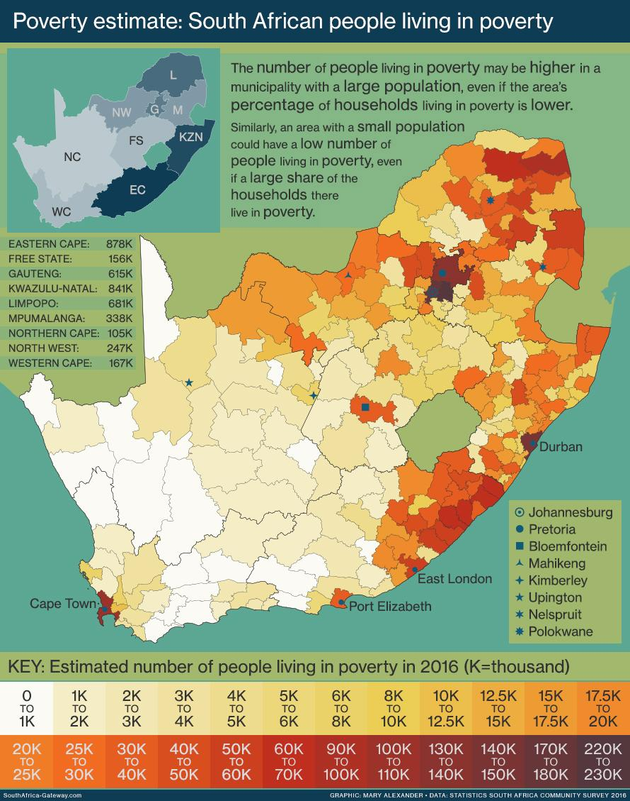
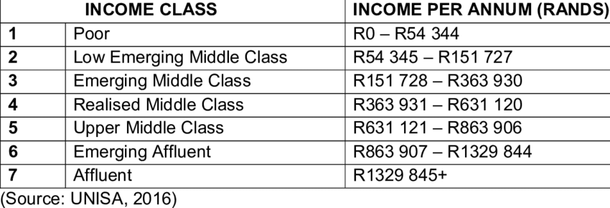
INCOME AND POVERTY LEVEL DATA
Slide 26: APPENDIX.
Alexander, Mary. “Mapping Poverty in South Africa.” South Africa Gateway, November 11, 2022. https://southafrica-info.com/people/mapping-poverty-in-south-africa/.
“(PDF) Early Childhood Development in South Africa ... - Researchgate.” ResearchGate, November 1, 2018. https://www.researchgate.net/publication/337033694_Early_Childhood_Development_in_South_Africa_Inequality_and_Opportunity.

Slide 31
Slide 26: APPENDIX.
APPENDIX: CLUSTER ANALYSIS (HEINEKEN)

Slide 32
Cluster Analysis (Heineken)
Slide 26: APPENDIX.
 | brand_name | sub_category | volume_hl | product_name | pack_size | units_purchased | state | channel | segment | municipality | poverty_class | census_land_type
Cluster 1 | HEINEKEN (59%) | BEER - PREMIUM - INTERNATIONAL PREMIUM (77%) | 0.095109239 | Heineken Lager NRB 330ml (14%) | 1 (70%) | 12.78421962 | Eastern Cape (43%) | ON TRADE (80%) | REGULAR TAVERN (64%) | Nelson Mandela Bay Metropolitan (31%) | Low (83%) | Urban (77%)
Cluster 2 | AMSTEL LAGER (45%) | BEER - PREMIUM - INTERNATIONAL PREMIUM (79%) | 0.136315314 | Amstel Lager Can 440ml (17%) | 1 (74%) | 20.44995088 | Mpumalanga (68%) | ON TRADE (75%) | REGULAR TAVERN (61%) | Emalahleni (10%) | Low (67%) | Traditional/Tribal (93%)
Cluster 3 | HEINEKEN (63%) | BEER - PREMIUM - INTERNATIONAL PREMIUM (95%) | 1.962667207 | Heineken Lager NRB 650ml (57%) | 1 (97%) | 274.6703231 | Mpumalanga (66%) | ON TRADE (77%) | REGULAR TAVERN (66%) | Steve Tshwete (8%) | Low (63%) | Traditional/Tribal (80%)
Cluster 4 | WINDHOEK LAGER (41%) | BEER - PREMIUM - LOCAL PREMIUM (62%) | 0.183871029 | Windhoek Lager RB 660ml (16%) | 1 (83%) | 29.22602998 | Limpopo (58%) | ON TRADE (93%) | REGULAR TAVERN (72%) | Greater Tzaneen Local Municipality (12%) | Middle (86%) | Traditional/Tribal (98%)

Slide 33
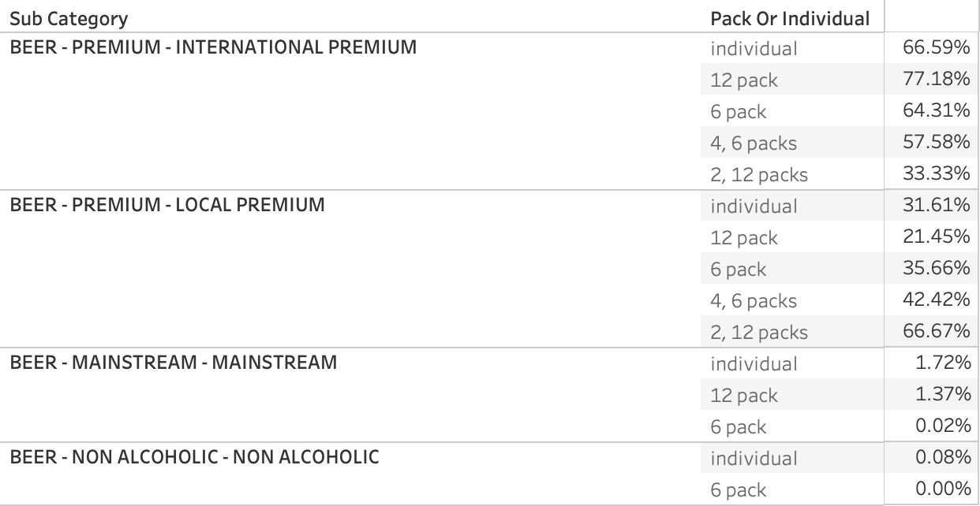
TOP PRODUCTS
Slide 26: APPENDIX.

Slide 34
Slide 26: APPENDIX.
APPENDIX: DISTRIBUTION CENTERS

Slide 35
ASSUMPTIONS & REFERENCES
Slide 26: APPENDIX.
Johannesburg:
Authors. “Heineken Expands South African Brewery as Demand Grows.” BRAUWELT, August 12, 2019. SA brewery - demand grows
https://www.engineeringnews.co.za/article/heineken-to-increase-sedibeng-brewery-capacity-to-75m-hectolitres-by-2020-2019-07-29.
Shipment Costs:
Ton: Liter Conversion:
1 Ton = 2831.6846592 Liters
Cost per ton/km in South Africa:
https://fleetwatch.co.za/wp-content/uploads/2019/09/pg-61-65.pdf
Difference between long haul, short haul, and medium haul
https://www.indeed.com/career-advice/finding-a-job/short-haul-vs-long-haul-trucking
Storage space capacity:
https://www.shipbob.com/blog/warehouse-capacity/
Beer keg size measurement
https://www.beveragecraft.com/blog/beer-keg-sizes#:~:text=The%20standard%20sixth%20barrel%20keg,or%20pin%2Dlock%20connection).
Employee Average Salary
https://www.timedoctor.com/blog/average-salary-in-south-africa/
Land
https://uni24.co.za/how-much-is-land-in-south-africa/
Building warehouse
https://www.newstreaming.com/how-much-does-it-cost-to-build-a-distribution-center/#:~:text=Depending%20on%20the%20style%2C%20design,Analysis%20and%20planning
Administrative/Ops Cost
https://www.prologis.com/what-we-do/resources/best-ways-to-reduce-warehouse-costs#:~:text=Warehouse%20costs%20vary%20based%20on,administration%20and%20general%20administrative%20expenses.
Name Change reason
https://www.npr.org/2021/03/23/980234491/south-africas-port-elizabeth-will-now-be-called-gqeberha
Name changes (2021-2023):
https://en.wikipedia.org/wiki/List_of_renamed_places_in_South_Africa
Ethnic Group Spread
https://welections.wordpress.com/guide-to-the-2014-south-african-election/race-ethnicity-and-language-in-south-africa/
Public Holidays:
https://www.gov.za/about-sa/public-holidays (2023)
https://www.officeholidays.com/countries/south-africa/2022 (2022)

Slide 36
Slide 26: APPENDIX.
TOTAL ANNUAL COSTS - 3 Centers (Polokwane, Witbank, & East London)
 | Baseline | 1 | 5 | 10
Operational | $0.00 | $8,493,961.81 | $2,638,736.64 | $2,638,736.64
MF -> DC Shipping | $212,167.57 | $222,775.94 | $270,785.55 | $345,598.61
DC -> City Shipping | $130,535.85 | $137,062.64 | $166,600.50 | $212,629.15
TOTAL COSTS | $342,703.42 | $8,853,800.39 | $3,076,122.69 | $3,196,964.39
Found closest large city to midpoint of customers
one center: of all data,
three centers: each state
Plotted longitude and latitude of each city and calculated distance in km with radians
Cost of Operations
Historic 2 week hL(yr 10) for facility size
one center: 7000hL
three center: 2700hL each
Converted barrels to sq ft needed
one center: 35,750.40 ft²
three center: 13,789.44 ft² each
Estimated building cost at $65 per ft²
one center: $6.5 M
three center: $1.95M each
Estimated land cost at $2,528.98 per acre
one center: $5,805.74
three center: $1,741.72 each
Estimated annual maintenance cost at $2 per ft²
one center: $71,500.80
three center: $27,578.88 each
Estimated annual cost of equipment
one center: $36,000
three center: $12,000 each
Estimated annual cost of labor $24k salary
one center: $2.4 M
three center: $840,000 each
Cost of shipping
Converted historic 2 week hL by city to tons
5% annual growth rate to volume
Calculated cost to travel to each location
240> km: 0.40 per ton km
240< km: 0.10 per ton km
TOTAL ANNUAL COSTS - 1 Center (New Castle)
 | Baseline | 1 | 5 | 10
Operational | $0.00 | $9,013,306.54 | $2,507,500.80 | $2,507,500.80
MF -> DC Shipping | $111,716.28 | $117,302.09 | $142,581.43 | $181,974.05
DC -> City Shipping | $180,669.60 | $189,703.08 | $230,585.28 | $294,291.74
TOTAL COSTS | $292,385.88 | $9,320,311.71 | $2,880,667.51 | $2,983,766.59
Annual Cost Difference | $50,317.54 | ($466,511.32) | $195,455.18 | $213,197.80
Total Difference (10 year) | ($7,540.80)
Notes:
Shelf space someone else doesn't get

Slide 37
Slide 26: APPENDIX.
APPENDIX: BRAND FORECASTS

Slide 38
Brand Predictions
Slide 26: APPENDIX.
 | AMSTEL_LAGER | AMSTEL_RADLER | Heineken | Sol | Soweto_Gold | Tafel Lager | Windhoek Draught | Windhoek Lager | Windhoek Light
2/9/2023 | 79.563617 | 0.00627473 | 217.7274 | 4.904679 | 1.737763 | 0.005868 | 24.552048 | 41.026066 | 0.017116051
2/16/2023 | 76.438793 | 0.006127678 | 188.8981 | 4.229714 | 2.241284 | 0.0050222 | 21.315683 | 38.99234 | 0.017116051
2/23/2023 | 75.558342 | 0.006226944 | 183.2289 | 4.081723 | 2.544048 | 0.0042273 | 20.599736 | 38.096697 | 0.017116051
3/2/2023 | 79.099182 | 0.00610674 | 198.7313 | 4.464439 | 2.805825 | 0.0034213 | 22.57168 | 39.119357 | 0.017116051
3/9/2023 | 81.62075 | 0.007101377 | 227.4853 | 5.004333 | 2.972422 | 0.0029211 | 25.347483 | 42.276905 | 0.017116051
3/16/2023 | 81.556173 | 0.006279164 | 237.7803 | 5.219562 | 3.187275 | 0.0026174 | 24.288951 | 43.414951 | 0.017116051
3/23/2023 | 78.88338 | 0.0068388 | 223.2396 | 5.04556 | 3.412545 | 0.0023874 | 20.944066 | 40.897674 | 0.017116051
3/30/2023 | 75.407959 | 0.007474303 | 204.8548 | 4.70662 | 3.720275 | 0.0021145 | 18.152453 | 35.743112 | 0.017116051

Slide 39
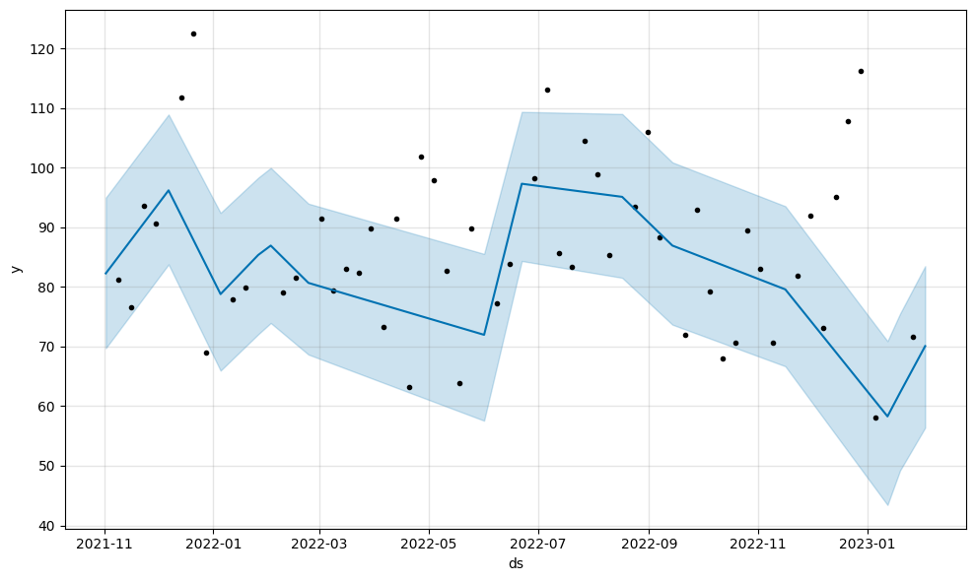
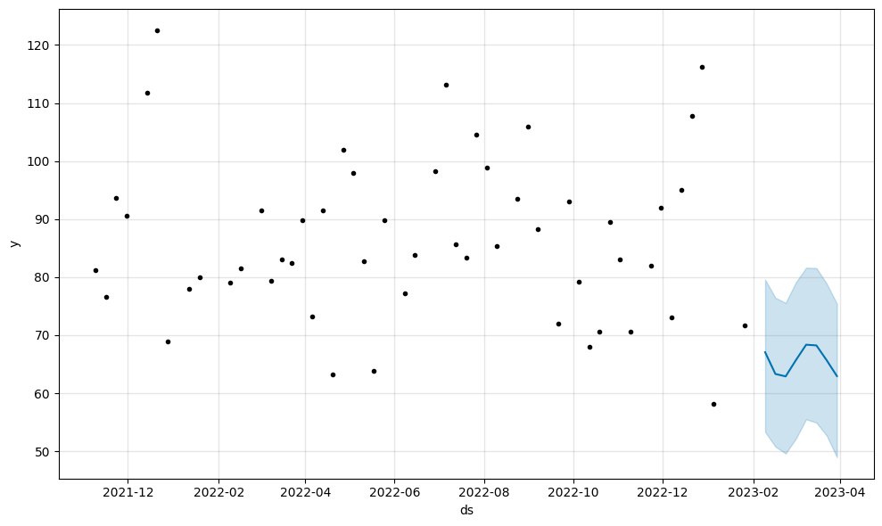
Amstel Lager Model
MAPE = 22.358368503225346. Upper Level of 95% CI used as predictions.
Slide 26: APPENDIX.

Slide 40
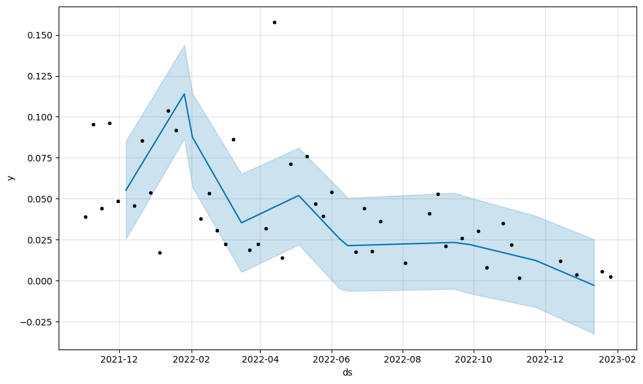
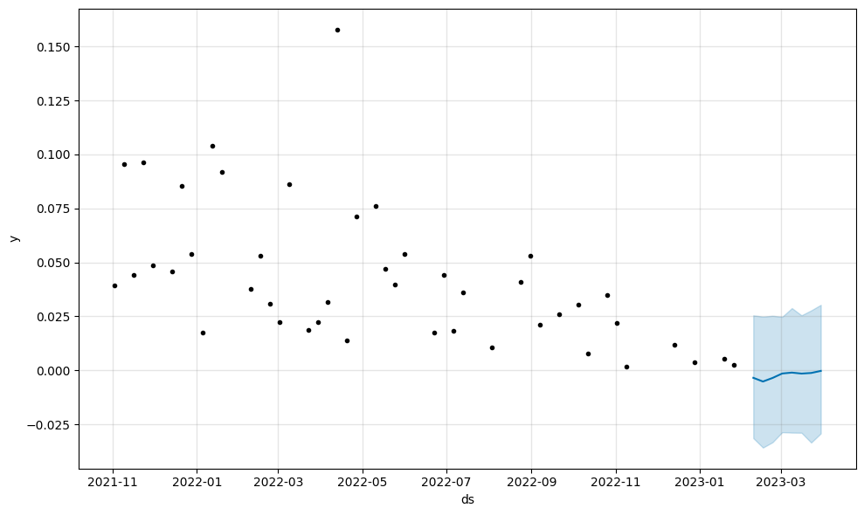
Amstel Radler Model
Amstel Radler Model: MAPE = 87.44849217560599. Model predicted this brand going to 0 hL. Predictions based on historical 7-week average for the brand.
Slide 26: APPENDIX.

Slide 41
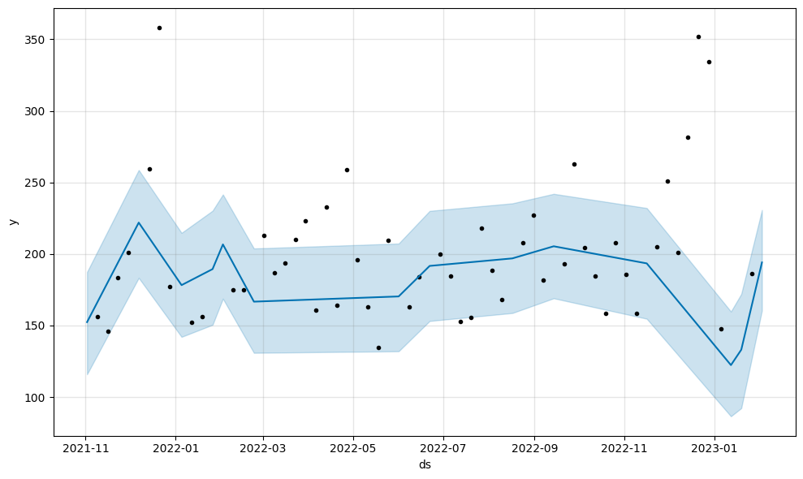
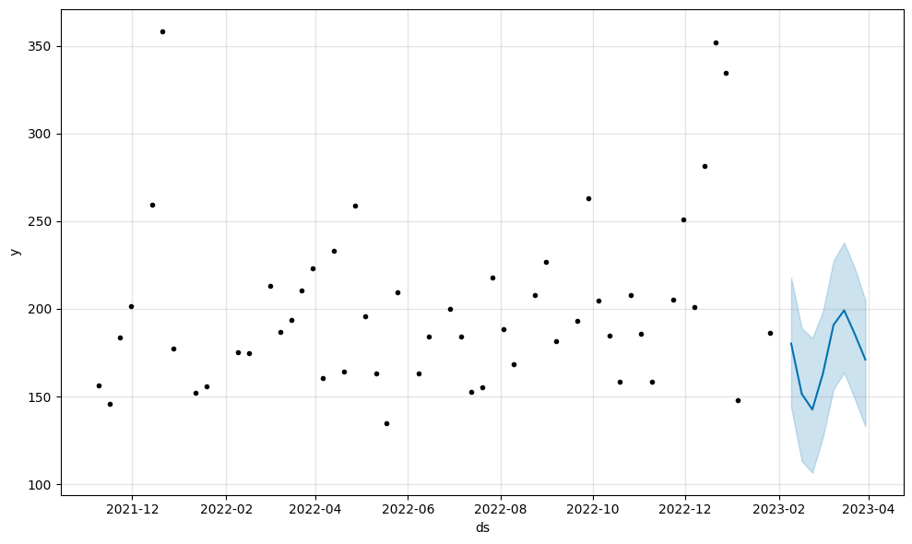
Heineken Model
Heineken: MAPE = 12.180027656878009. Upper Level of 95% CI used as predictions.
Slide 26: APPENDIX.

Slide 42
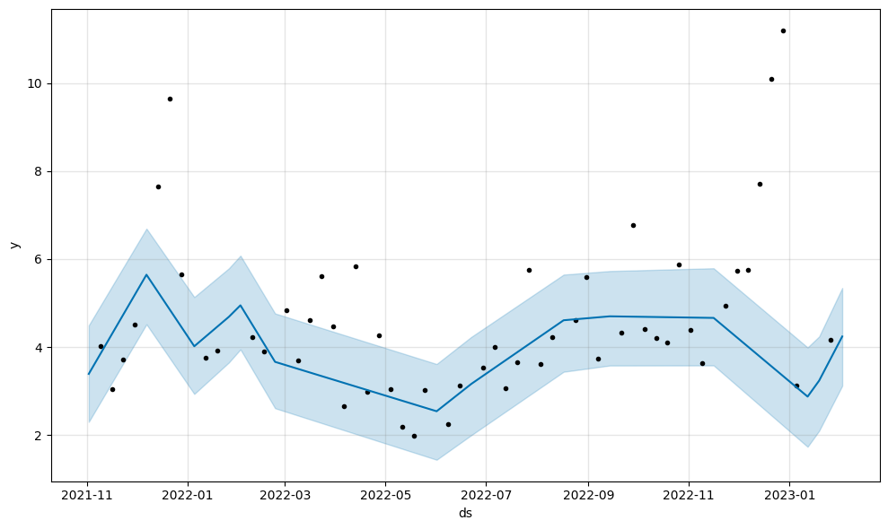
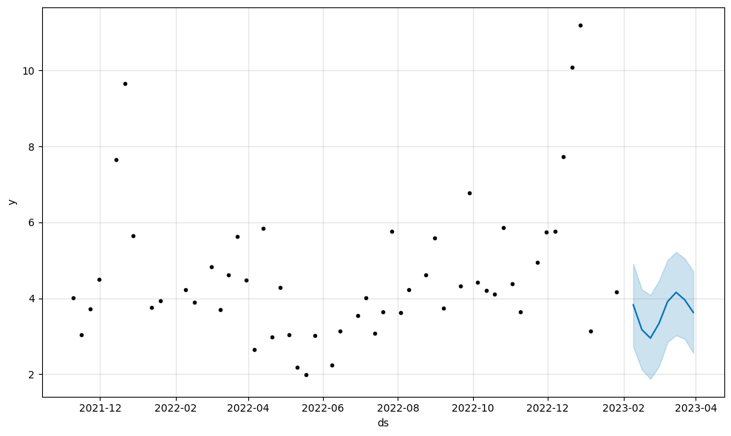
Sol Model
MAPE = 32.707699818528006. Upper Level of 95% CI used as predictions.
Slide 26: APPENDIX.

Slide 43
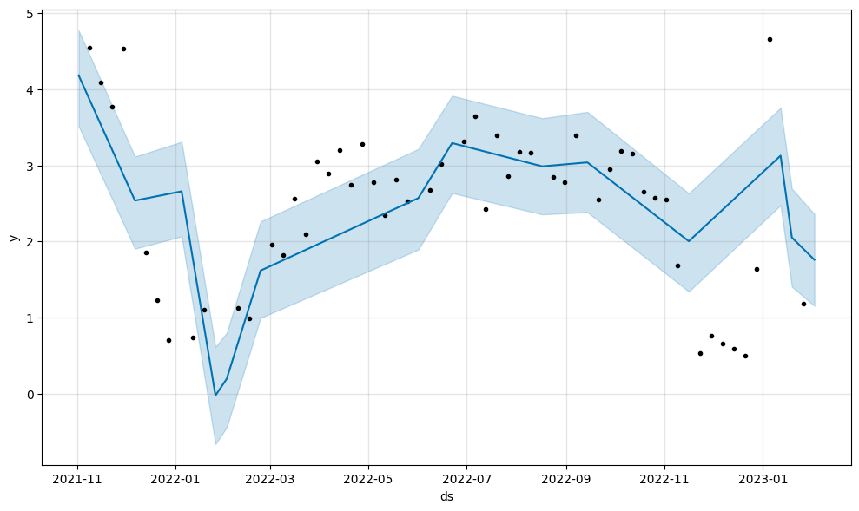
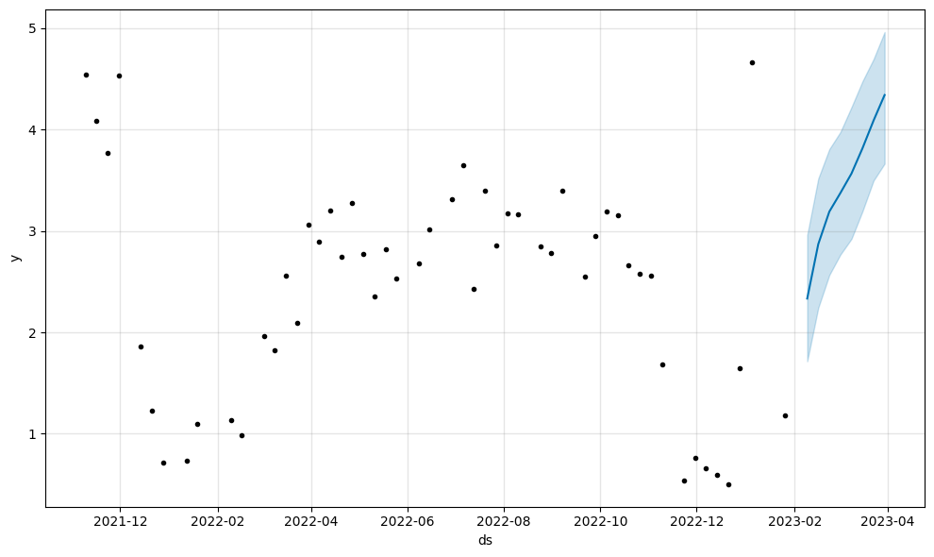
Soweto Gold Model
MAPE = 114.2494520166475. Lower Level of 95% CI used as predictions.
Slide 26: APPENDIX.

Slide 44
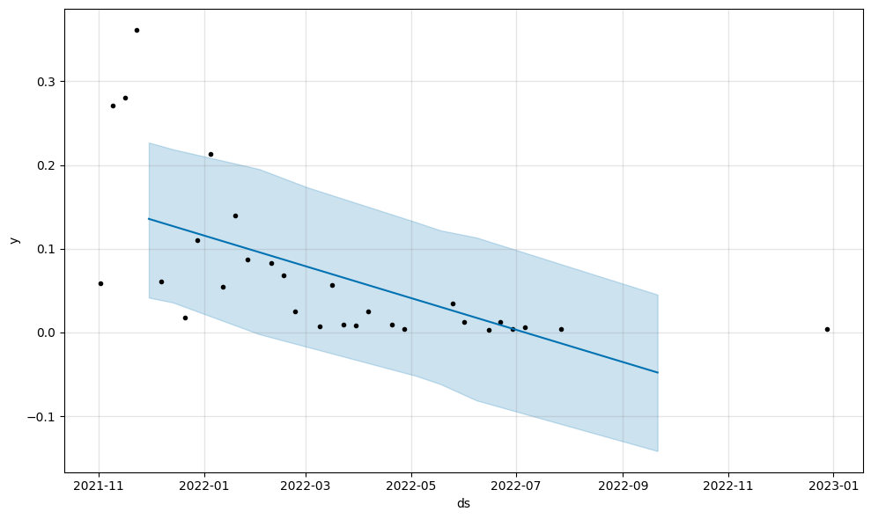
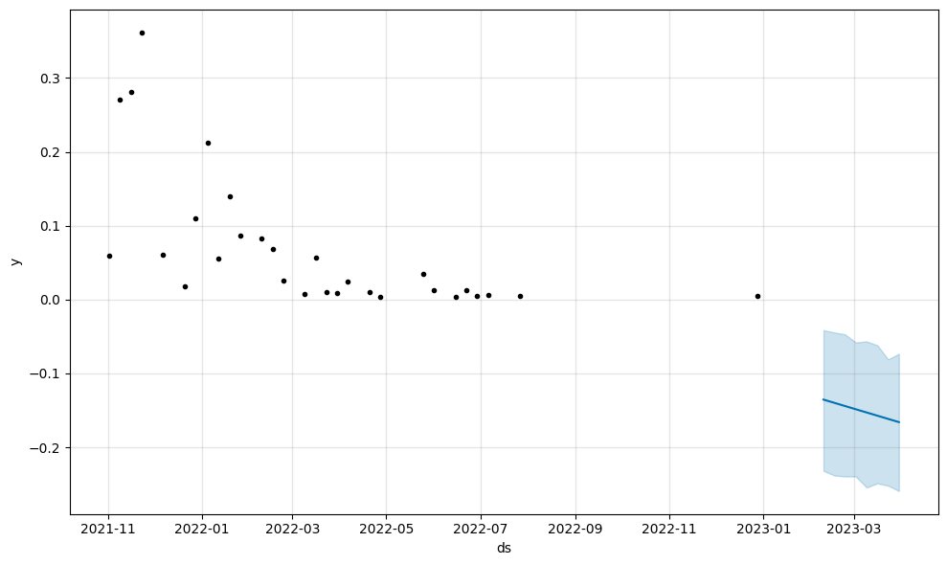
Tafel Lager
MAPE = 506.7036089453941. Data limitations led to negative model predictions. Used 5-week historical average and percentage change.
Slide 26: APPENDIX.

Slide 45
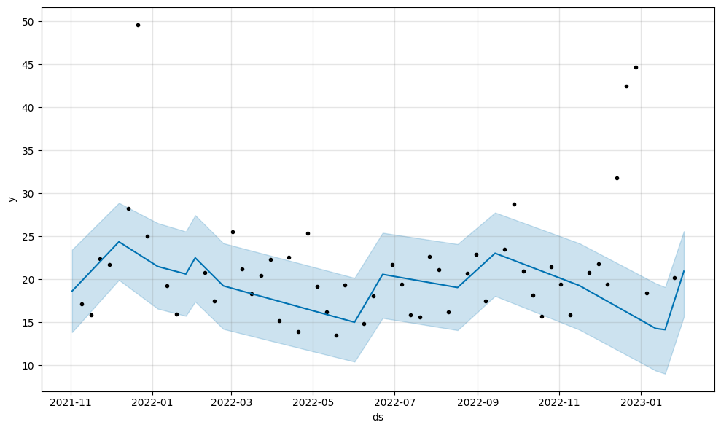
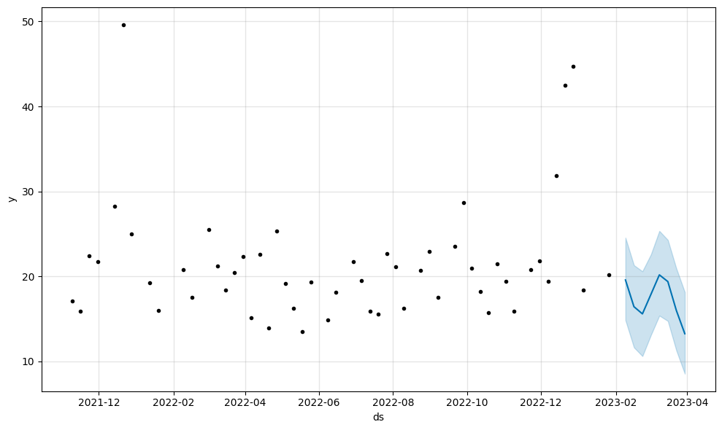
Windhoek Draught
MAPE = 18.985876679822617. Upper Level of 95% CI used as predictions.
Slide 26: APPENDIX.

Slide 46
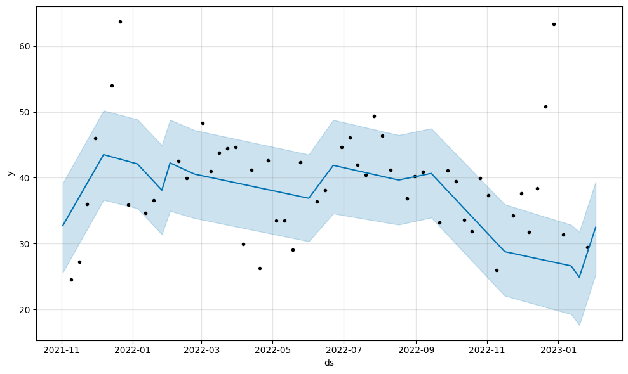
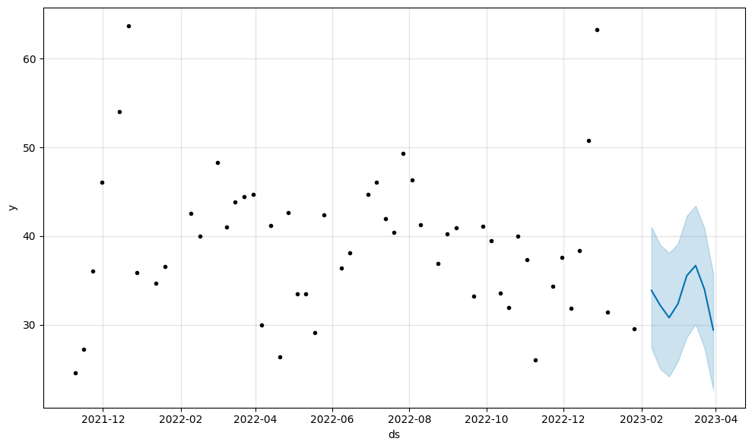
Windhoek Lager
MAPE = 25.431403508881434. Upper Level of 95% CI used as predictions.
Slide 26: APPENDIX.

Slide 47
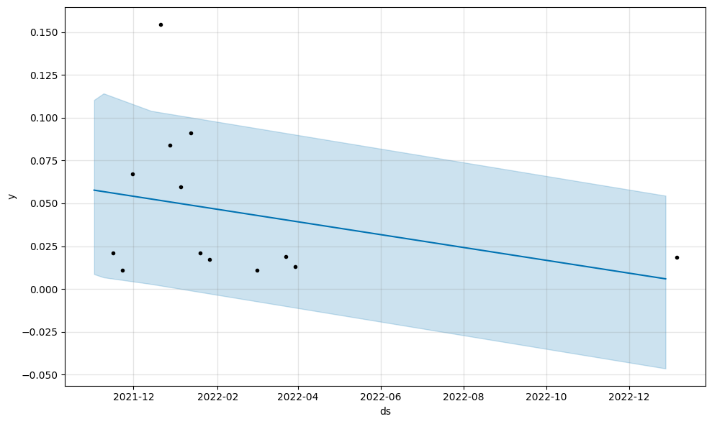
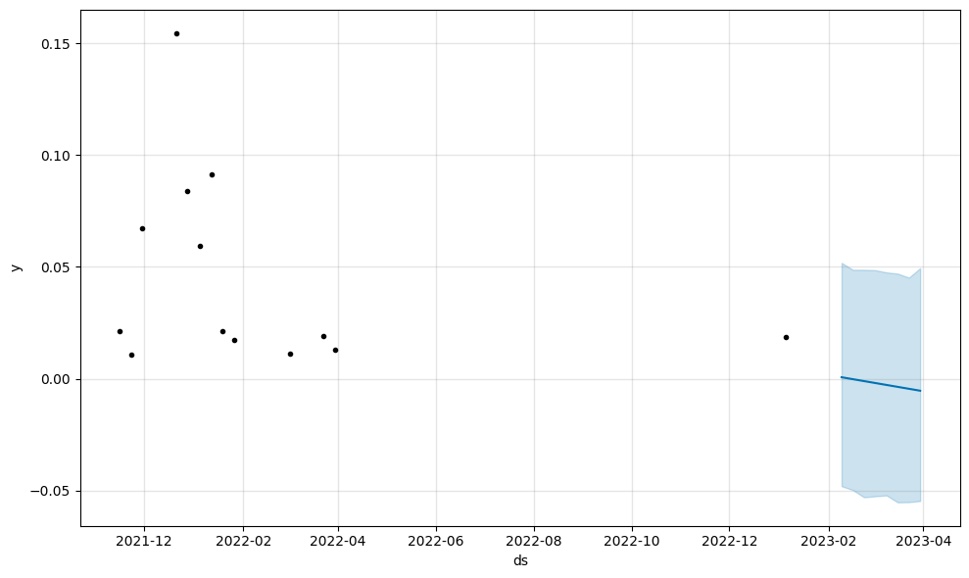
Windhoek Light
MAPE = 122.68295584330158. We used the 3-week average of 0.017116051 for the final predictions. .
Slide 26: APPENDIX.

Slide 48
Slide 26: APPENDIX.
APPENDIX: BRAND BETTING & SUN SETTING

Slide 49
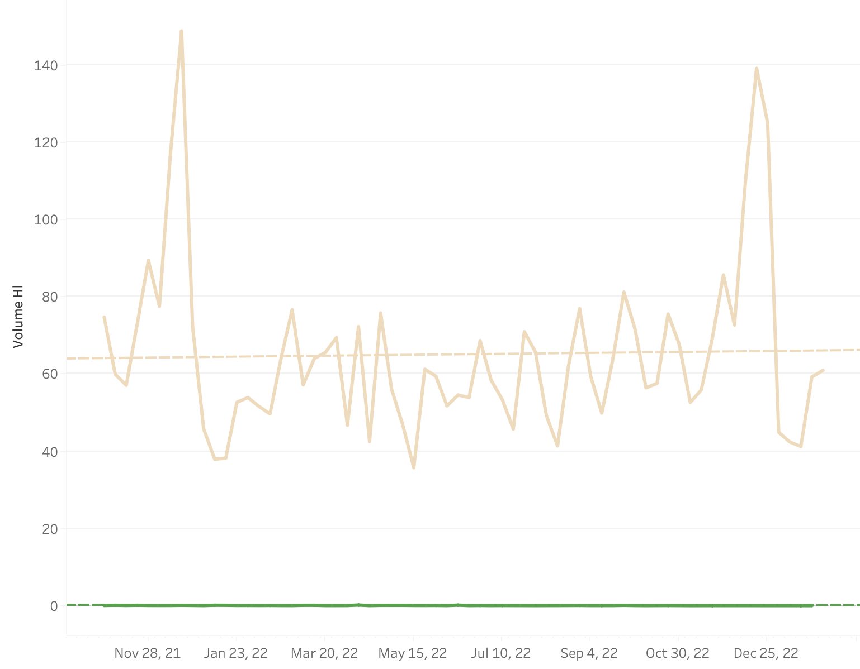
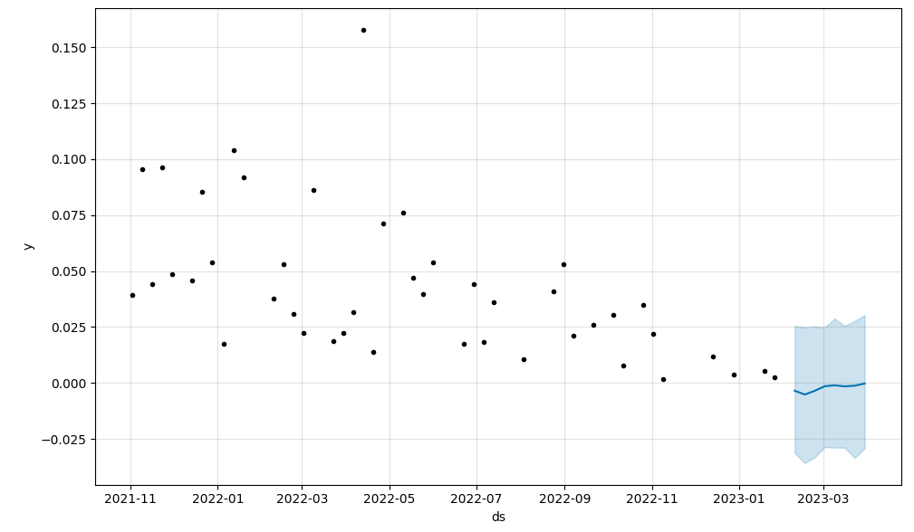
SUNSETTING: Amstel Radler
Slide 26: APPENDIX.
Mainstream Category
The brand has been decreasing steadily over the time period
Predictive model shows volume_hl going to 0
Light beer with fruity and lemon undertones (closest competitor is flying fish)
May not appeal to SA consumer tastes
One of the worst performing premium international brands

Slide 50

SUNSETTING: Tafel Lager
Slide 26: APPENDIX.
Growing and capturable market for lagers in the mainstream category (show two line charts from Tableau)
Remove this brand to focus on the Amstel Lager and Windhoek Lager which have been performing well
Lager Market increasing - drop one double down

Slide 51
SUNSETTING: Windhoek Light
Slide 26: APPENDIX.
Decreasing market share (hL) and predictions go to zero
Closest competitor Castle Light not performing well
SA Consumer preferences might not be suitable for Light beers
Light market decreasing volume as a whole

Slide 52
POSSIBLE BETTING: Soweto Gold
Slide 26: APPENDIX.
Lager beer which sees upward trends in Spring
Mainstream beer that performs well against competitors
Could be focused more on for local market

Slide 53
BETTING: Flavored Beers
Slide 26: APPENDIX.
Flavored beer popularity keeps rising - in volume purchased
Competitors are seeing consistent demand
Flying Fish Pressed Lemon
Launch Sol flavored returnable bottles (RB)
Returnable bottle more popular than NRB

Slide 54
BETTING: International Premiums
Slide 26: APPENDIX.
International Premium performing well
Heineken Original sees tremendous success
Increased investments could be made in marketing and supply efforts

